Slide 1
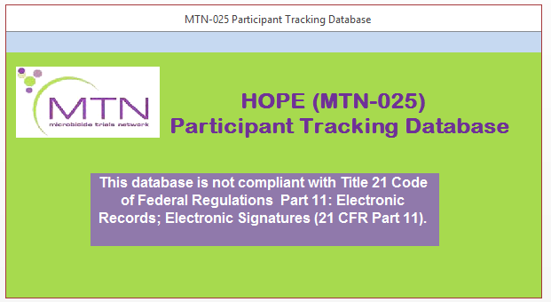

Slide 2
Participant Tracking Database (PTD) Overview
Access database is an optional tool for tracking participant visit scheduling and visits throughout HOPE
Very similar to the MTN-020/ASPIRE PTD
The database is an Access 2000-2003 file. Please contact your site IT for technical issues related to Microsoft Access versioning.
Notes:
This Access database is an optional tool that you can use for tracking participant visit scheduling and visits throughout the study. The database is very similar to the participant tracking database provided in ASPIRE with a few updates based on sites’ feedback at the end of study.
The database was created as an Access 2000-2003 file. If you have a previous version of Microsoft Access, you may experience some minor technical issues when using the database. If you have a subsequent version of Microsoft Access installed on your computer, you should not experience any challenges in utilizing this database. Please contact your site IT department for any issues related to Microsoft Access versioning.

Slide 3
Database Main Functions
A. Follow-up visit schedule
B. Listings of screened participants with one or two weeks left to enroll
E. Listings of study participants who are due or late for scheduled visits
C. Summary screening and enrollment reports
D. Listings of scheduled and completed study visits
Notes:
The main functions of this database include:
Creation of a follow-up visit schedule for each participant based on the participant’s specified enrollment date
Listings of screened participants with one week left to enroll or two weeks left to Enroll depending on the date that listings are generated
Listings (by past week, calendar month and cumulative) of the number of screening and enrollments visits completed at your site
The database provides listings of scheduled and completed follow-up study visits, and
Listings of study participants who are due or late for scheduled visits in order to help provide visit reminders and conduct participant outreach and retention efforts.

Slide 4
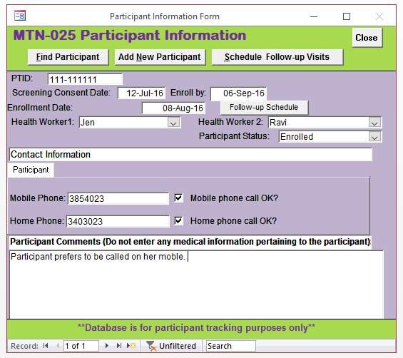
Database Main Functions
A. Follow-up visit schedule
Notes:
This slide provides an example of the participant information form that will appear once an participant is added to the database. Here you will provide the assigned PTID, which was generated by the MTN-025 Medidata Rave database and the screening consent date. The date by which the participant will need to be enrolled will be calculated. When the enrollment date has been entered, the follow-up schedule will be generated by clicking on the “Follow up Schedule” button. Please note that in order to schedule follow-up visits, the follow-up schedule must be generated first. Attempting to schedule follow-up visits prior to generating a follow-up schedule will incur an error message. Upon enrollment, the participant status field will be updated to “enrolled’. Should the participant’s status change during the course of the study, this drop down field will need to be updated manually.
Site health workers can be added to the database and assigned to each participant within the database. Up to two health workers can be assigned to any given participant. The participant’s mobile phone and home phone number can be entered on the participant’s information page with a note to indicate whether it ok to contact the participant on her mobile or home phone. There is space to provide some additional information about this participant at the bottom of the page. Please note, however, that any information that pertains to a participant’s medical records or history should not be entered into the database. Additionally, any information inputted into this database should not be considered source and should be documented elsewhere in the participant’s file.

Slide 5
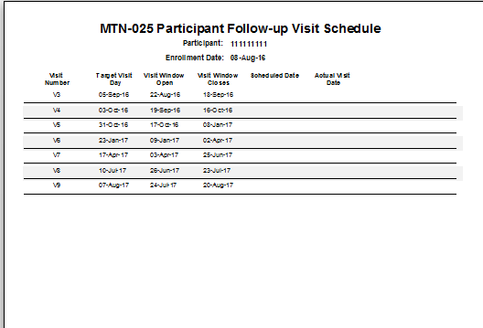
Database Main Functions
A. Follow-up visit schedule
Notes:
The first main function of the database is to generate a participant’s follow-up schedule. Once the participant’s enrollment date is entered, the participant specific follow-up visit schedule can be generated. This visit schedule is similar to the excel visit scheduling tool that is provided separately on the study webpage. When visits are added to the database, the scheduled date and actual dates will be populated in this schedule. The visit schedule is provided as a PDF that can printed and stored in the participant’s binder, if needed.

Slide 6
Database Main Functions
A. Scheduling Follow-up Visits
Notes:
To schedule follow-up visits, navigate back to the Participant Information Form and click on the Schedule Follow-up Visits button. Again, please ensure that the follow-up schedule has been generated prior to scheduling future study visits.

Slide 7
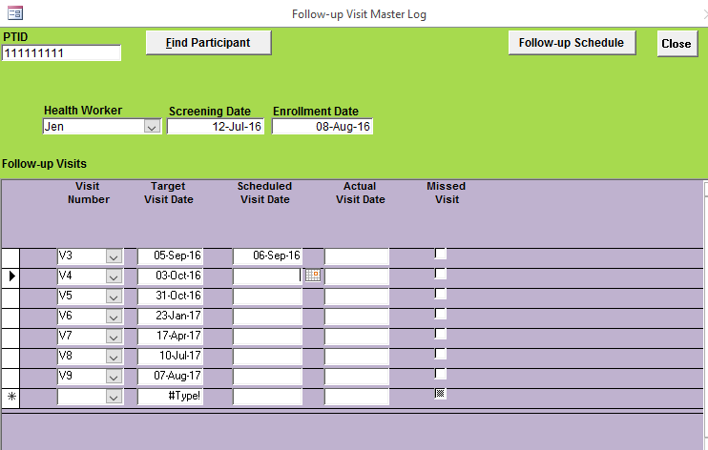
Database Main Functions
A. Scheduling Follow-up Visits
Notes:
clicking on the Schedule Follow-up Visits button will bring you to the follow-up visit master log where scheduled visit dates and actual visit dates can be entered throughout the study. There is an option to indicate that the visit was missed. This form also has a link at the top right hand corner to generate a follow-up schedule once updates are made to future visits.

Slide 8
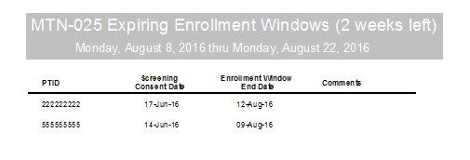
Database Main Functions
B. Listings of Screened Participants With One or Two Weeks Left to Enroll
Notes:
The second main function of the database is to generate reports that might be useful for tracking and planning purposes at your site. The first two screening reports that are available to you provide listings of participants who have completed their screening visit and who must enroll by a certain date per the protocol specified screening window of 56 days. The report on the top of this slide shows a list of all screened participants whose screening windows end within the next fortnight. For example, the first participant listed had a screening visit on June 17, 2016. The report was generated on August 8 and indicates that her screening to enrollment window ends on August 12 and so every effort should be made to ensure that she is able to come into the clinic for her Enrollment visit prior to that date.
The second listing indicates all participants who have 1 week left to enroll.

Slide 9
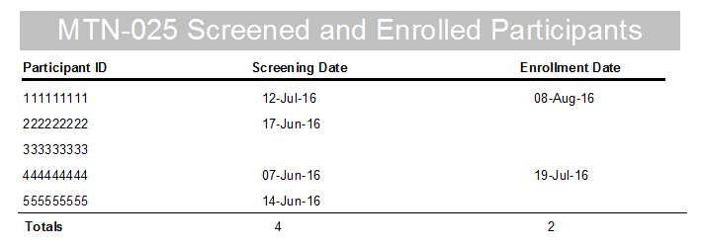
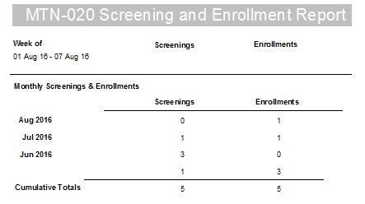
Database Main Functions
C. Summary Screening and Enrollment Reports
Notes:
The participant tracking database also provides a summary of all screening and enrollment visits that have been completed at your site. The Screened and Enrolled Participants report at the top of the slide provides a cumulative list of participants and a row to provide the total number of visits thus far. The second report breaks down these visits by indicating the number of screening and enrollment visits that have been completed in the last week as well as the number of visits completed by calendar month.

Slide 10
Database Main Functions
D. Listings of scheduled and completed study visits
Listings for visits scheduled within the two weeks:
Monthly summary of scheduled and actual visits:
Notes:
The participant tracking database also provides reports that help to track future visits that are scheduled within the next two weeks. The first report that was generated on August 8 shows a list of all PTIDs who have a visit scheduled between August 8 and August 22. The visit type, scheduled visit date, how days away that visit is from the date that the report is generated as well as whether the participant has provided permission for reminder phone calls is provided for each visit scheduled.
The second report provides a summary to compare visits that have been scheduled and those visits that have been completed. These reports may help you for planning purposes and to see overall metrics of visit completion at your site.

Slide 11
Database Main Functions
E. Listings of study participants who are late for scheduled visits
Notes:
The last report that I want to highlight is a listing that can be generated to show all participants who are late for their scheduled follow-up visits. Participants who are included in this listing were not able to attend their scheduled visits and may require additional follow-up to reschedule their visit within the allowable visit window. The purpose of this listing to provide a guide for sites to follow-up with participants to ensure that they are able to attend their visit, if at all possible.

Slide 12
PTD User Manual
PTD User Manual provides detailed information and instructions for entering and updating visits and generating reports.
Please refer to this document to review tips for navigating the database
Notes:
This presentation provides an overview of some of the key components and features of the database. For additional information on key navigational components of the database please refer to the Participant Tracking Database User’s Manual (version 1.0) which is available on the study webpage as a separate PDF. This user manual provides some detailed information on different components of the database as well as key tips in optimizing the use of the database as well as some troubleshooting information should you encounter any issues when opening and navigating the database.

Slide 13
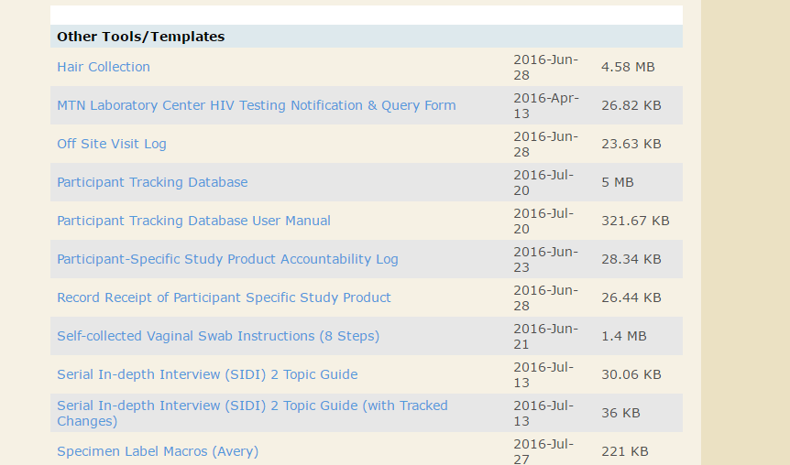
Database Logistics
Database and User Manual located on the MTN-025 Study Implementation Materials Webpage under ‘other tools/templates’: http://www.mtnstopshiv.org/node/7330
Notes:
Version 1.0 of the participant tracking database is available to download from the MTN-025 Study Implementation Materials webpage under the ‘other tools/templates’ section. A PDF of v1.0 of the user manual is also available and should be downloaded together with the database.

Slide 14
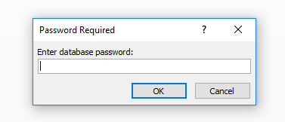
Password Encryption and Security
Database is password encrypted for security purposes
Password will need to be entered each time the database is opened
SCHARP will send password via email upon site activation
The PTD should be downloaded onto a secured site computer.
Notes:
This database has been encrypted with a password that you will need to enter each time the database is opened. The password for the database will be sent via email from SCHARP to the sites upon activation and should be stored in a secure location.
Please note that the database should be downloaded onto a secured site computer that is also password protected. The database should not be backed-up or stored on multiple devices/locations, but rather kept in a central location to ensure limited access to information stored within the database.

Slide 15
Questions?
Contact the HOPE Clinical Data Managers:
Jen Berthiaume (jberthia@scharp.org)
Melissa Peda (mapeda@scharp.org)

